Slide 1
CHAIN RULE & PIPES AND CISTERNS

Slide 2

Pipes and Cistern
Introduction
Concept of pipes and cistern
Problems related to Partial Work
Problem Based on Alternate Work
Problems based on efficiency
Chain Rule
Concept of Direct Proportional & Indirect Proportional
Problem based on Chain rule
DI and DS

Slide 3
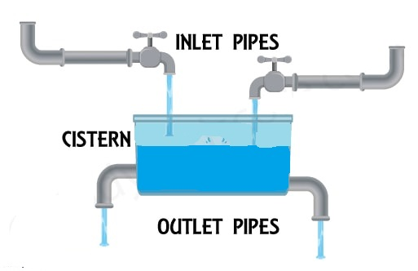
PIPES AND CISTERNSS
INTRODUCTION TO PIPES AND CISTERN
Inlet: An inlet is a pipe which is connected to the tank and with the help of this pipe, the tank is filled.
Outlet/Leak: An outlet is a pipe which i drains out water from the tank and the tank gets emptied if this
pipe is opened.
Concepts
A certain amount of time (T) is taken to complete a certain work (W). The number of units of work done per unit time is called the efficiency of work (E). Hence, Work (W) = Efficiency (E) x Time (T)
Notes:
Option C

Slide 4
PIPES AND CISTERNSS
Important Formula on Pipes and Cistern
If x hours are required to fill up a tank, then part filled in 1 hr =1/x
If y hours are required to empty the tank, then part emptied in 1 hour = 1/y
If a first pipe can fill a tank in x hours and a second pipe can empty the same tank in y hours. When both the pipes are opened at the same time, then time taken to fill the empty tank = {(xy) / (y-x)}, provided y>x
If a first pipe can fill a tank in x hours and a second can empty the same tank in y hours. When both the pipes are opened at the same time, then time taken to empty the completely filled tank = {(xy) / (x-y)}, provided x>y
Net work done = (Sum of work done by Inlets) – (Sum of work done by Outlets)
One inlet can fill the tank in x hr and the other inlet can fill the same tank in y hrs, if both the inlets are opened at the same time,
the time taken to fill the whole tank = {(xy) / (y+x)}
Notes:
Option C

Slide 5
PIPES AND CISTERNSS
1) Pipe 1 can fill a tank in 39 minutes and pipe 2 can fill it in 52 minutes. If both the pipes are opened to fill an empty tank, in how many minutes will it be full?
A]15.5 B]18 C]22 (2/7) D]25.5
E] None of these
Notes:
Difficulty level : Easy(Compulsory)
Option C

Slide 6
PIPES AND CISTERNSS
2) Pipe G and Pipe H can fill a cistern in 10 hours and 15 hours respectively. When a third pipe J which works as an outlet pipe is also open then the cistern can be filled in 18 hours. The outlet pipe can empty a full cistern in:
A]12 hours B]8 hours C]9 hours D]14 hours
E] None of these
Notes:
Difficulty level : Medium (Compulsory)
Option C

Slide 7
PIPES AND CISTERNSS
3) Tap A can fill the empty tank in 11 hours, but due to a leak in the bottom it is filled in 22 hours. If the tank is full and then tap A is closed then in how many hours the leak can empty it?
A]11 hours B]33 hours C]32 hours D]22 hours
E] None of these
Notes:
Difficulty level : Medium (Compulsory)
Option D

Slide 8
PIPES AND CISTERNSS
4) If one pipe A can fill a tank in 50 minutes, then 5 pipes, each of 50% efficiency of A, can fill the tank in:
A]80 min B]100 min C]20 min D] 25 min
E] None of these
Notes:
Difficulty level : Medium (Compulsory)
Option C

Slide 9
PIPES AND CISTERNSS
5) Two pipes A and B can fill a tank in 12 minutes and 20 minutes respectively. Both the pipes are opened together but after 4 minutes, pipe A is turned off. What is the total time required to fill the tank ?
A]10 min 20 sec B]11 min 45 sec C]12 min 30 sec D] 13 min 20 sec
E] None of these
Notes:
Difficulty level : easy (Compulsory)
Option D

Slide 10
PIPES AND CISTERNSS
6) Tap A fills a tank in 30 hours and B can fill it in 45 hours. Both are opened simultaneously. Sometimes later tap B was closed, then it takes total 24 hours to fill up the whole tank. After how many hours B was closed?
A]7 B]9 C]12 D]15
E] None of these
Notes:
Difficulty level : medium (optional)
Option B

Slide 11
PIPES AND CISTERNSS
7) A tank has 4 pipes P₁, P₂, P₃ and P₄. It can be filled in 12 minutes by P₁, P₂, P₃ together, it can be filled in 15 minutes by P₂, P₃ and P₄ and it can be filled by P₁ and P₄ in 20 minutes. Find if all are opened together then what is the time taken by them.
A]10 min B]15 min C]20 min D]25 min
E] None of these
Notes:
Difficulty level : Medium (Compulsory)
Option A

Slide 12
PIPES AND CISTERNSS
8) Two pipes A and B can fill a cistern in 3 hours 45 min. Had they been opened separately, then B would have taken 4 hours more than A to fill the cistern. How much time will be taken by A to fill the cistern separately?
A]1 hours B]2 hours C]6 hours D] 8 hours
E] None of these
Notes:
Difficulty level : Medium (Compulsory)
Option C

Slide 13
PIPES AND CISTERNSS
9) There are 3 pipes. P and Q together fill the tank in the same time during which the tank is filled R alone. Q fills the tank 40 hours faster than P and 32 hours slower than R. Find the time required by P to fill the tank?
A]100 hours B]120 hours C]170 hours D]180 hours
E] None of these
Notes:
Difficulty level : medium (Compulsory)
Option B

Slide 14
PIPES AND CISTERNSS
10) A leak in the bottom of a tank can empty the full tank in 8 hours. An inlet pipe fills water at the rate of 4 litres a minute. When the tank is full, the inlet is opened and due to the leak the tank is empty in 10 hours. The capacity of the tank (in litres) is
A]9780 litres B]9600 litres C]1000 litres D]9400 litres
E] None of these
Notes:
Difficulty level : medium (Compulsory)
Option B

Slide 15
PIPES AND CISTERNSS
11) Two pipes A and B can fill a tank in 15 hours and 10 hours respectively. If they are opened on alternate hours and if pipe A is opened first, in how many hours, the tank shall be full ?
A]13 hours B]12 hours C]17 hours D]10 hours
E] None of these
Notes:
Difficulty level : medium (Compulsory)
Option B

Slide 16
PIPES AND CISTERNSS
12) Tap A can fill a tank in 10 hours, B in 30 hours but tap C can empty a full tank in 25 hours. Starting with A, followed by B and C each tap opens alternatively for one hour period till the tank gets filled up completely. In how many hour the tank will be filled up completely?
A]27 hours B]21 hours C]20 hours D] Can’t be determine
E] None of these
Notes:
Difficulty level : Expert (Compulsory)
Option E

Slide 17
PIPES AND CISTERNSS
13) Pipe A can fill ½ of tank alone in 6 Hours and B can fill the 2 times of tank 12 Hours respectively. Another Pipe C can empty the 1/3 of same tank alone in 3 Hours. In an empty Tank for the First hour, Pipe A is opened alone, Second Hour pipe B is opened alone, Third Hour pipe C is opened alone. This process is continued until the Tank is filled. Then Pipe A is opened for How many Hours?
A]6 hours B]6 hours 10 min C]6 hours 15 min D]6 hours 30 min
E] None of these
Notes:
Difficulty level : Expert (Compulsory)
Option E

Slide 18
PIPES AND CISTERNSS
14) A cistern can be filled by two taps A and B in 30 and 40 minutes respectively. Both the taps are opened at the same time but due to partial closing of a valve in the main pipeline, tap A was supplying only 4/5th of its capacity and tap B, 5/6th of its capacity. After some time, the valve in the main pipeline was opened fully thereby enabling the two taps to supply at full capacity. It took another 5 minutes to fill the cistern completely. How long (approx.) was it before the valve on the main pipeline opened?
A]12 min B]19 min C]17 min D]13 min E] None of these
Notes:
Difficulty level : Expert(optional)
Option E

Slide 19
PIPES AND CISTERNSS
15) A tank is fitted with 16 pipes, some of which that fill the tank and others that empty the tank. Each of the pipes that fills the tank fills it in 10 hours, while each of those that empty the tank empties it in 8 hours. If all the pipes are kept open when the tank is full, it will take 5 hours to drain the tank. How many of these are fill pipes?
a.) 2 fill pipes
b.) 8 fill pipes
c.) 6 fill pipes
d.) 5 fill pipes
Notes:
Difficulty level : Expert(Compulsory )
Option -B

Slide 20
PIPES AND CISTERNSS
16) There are three pipes of diameters 2cm, 4/5 cm, 3cm receptively. The ratio of the water flowing through them is equal to the ratio of the square of their diameters. The biggest tap can fill the tank alone in 1 min. If all the taps are opened simultaneously, how long will the tank take to be filled?
A]225/341 min B] 225/342min C] 226/341 min D] 225/343 min E] None of these
Notes:
Difficulty level : Expert(Compulsory)
Option A

Slide 21
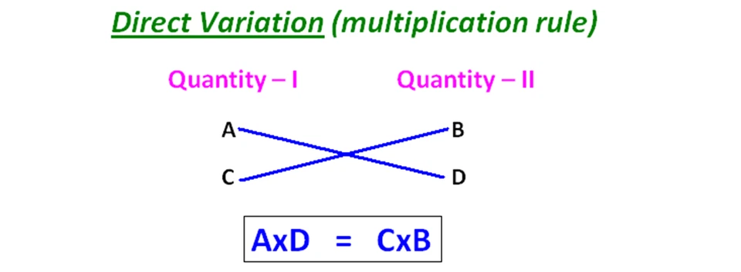
Chain Rule
Chain Rule Fundamentals:
Direct Proportion:
Two quantities are said to be directly proportional, if on the increase (or decrease) of the one, the other increases (or decreases) to the same extent.
Eg. Cost is directly proportional to the number of articles. (More Articles, More Cost)
Notes:
Option A

Slide 22
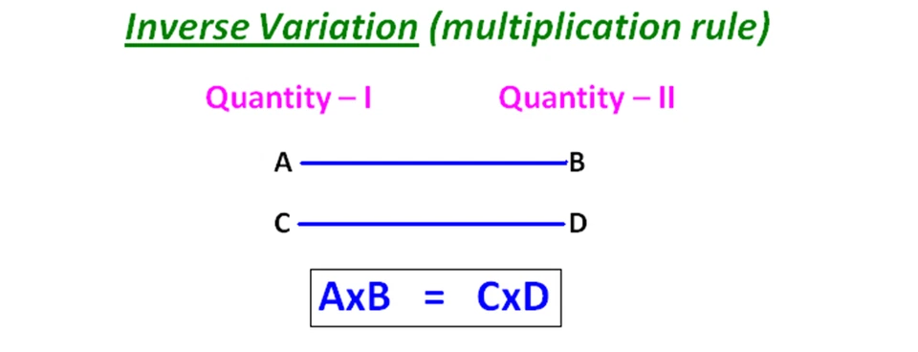
Chain Rule
Chain Rule Fundamentals:
b) Indirect Proportion:
Two quantities are said to be indirectly proportional, if on the increase of the one, the other decreases to the same extent and vice-versa.
Eg.. Speed is directly proportional to time when distance is constant.
Notes:
Option A

Slide 23
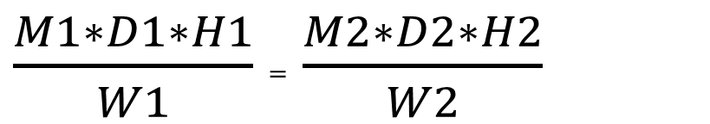
Chain Rule
Chain Rule Formula
If M1 number of men can complete a work W1 in D1 days working H1 hours per day and M2 number of men can complete a work W2 in D2 days working H2 hours per day then,
$\frac{M1∗D1∗H1}{W1}$ = $\frac{M2∗D2∗H2}{W2}$
Notes:
Option A

Slide 24
Chain Rule
17) 9 pumps, working 4 hours a day, can empty a tank in 2 days. How many hours a day must 8 pumps work to empty the tank in 1 day?
A]9 B]10 C]11 D]12
Notes:
Difficulty level : Medium (Compulsory)
Option A

Slide 25
Chain Rule
18) 51 persons can dig an area 17 m long, 6 m wide and 4 m deep working 5 hours a day in 38 days. Then how many persons can dig an area 20 m long, 18 m wide and 2 m deep working 10 hours a day in 19 days?
A]70 B]80 C]90 D]CND
Notes:
Difficulty level : medium (Compulsory)
Option C

Slide 26
Chain Rule
19) 160 persons can do a piece of work in 25 days. But after 5 days he found that 1/4th of the work is completed. How many persons can discharge now so that work get completed on time.?
A]25 B]30 C]35 D]40
Notes:
Difficulty level : easy (Compulsory)
Option D

Slide 27
Chain Rule
20) A person undertakes to make a road in 35 days and employs 70 men. After 25 days he finds that 2/3rd of the road is made. How many extra men should he employed so that he is able to complete the work 5 days earlier.
A]150 B]175 C]105 D]None
Notes:
Difficulty level : medium (optional)
Option C

Slide 28
Chain Rule
21) 1 man or 3 women or 5 children can finish a work in 69 days. Then in how many days 1 man, 1 woman and 1 child together can do the same piece of work ?
A]24 B]30 C]45 D]35
Notes:
Difficulty level : easy (Compulsory)
Option C

Slide 29
Chain Rule
22) 10 men can complete a piece of work 30 days. After 5 days 20 women accompanied them to complete the work in next 20 days. If only 20 women do the same work in how many days they will complete it?
A]120 B]100 C]160 D] CND
Notes:
Difficulty level : medium (Compulsory)
Option A

Slide 30
Chain Rule
23) 25 men can complete a piece of work in 12 days, 3 days after they started working 2 more men joined them and after 5 more days 7 men left. How many more days will they now take to complete the remaining work?
A]4.5 days B]6.5 days C]5days D] None
Notes:
Difficulty level : easy (optional)
Option A

Slide 31
Chain Rule
24) 6 men and 14 women can do a job in 10 days, while 8 men and 25 women can do it in 6 days. The number of days required for a group of 3 men and 7 women working together, at the same rate as before, to finish the same job in?
A]15 B]20 C]25 D]30
Notes:
Difficulty level : medium (Compulsory)
Option B

Slide 32
Chain Rule
25) 18 men take 15 days of 12 hours each to complete a work. How many days of 6 hours each would 24 women take to complete the same piece of work. If it is given that work done by 2 men is equal to work done by 3 women?
A]30 B]45 C]33.75 D]31.75
Notes:
Difficulty level : medium (optional)
Option C

Slide 33
Chain Rule
26) In a boys hostel there is provision of food for 200 students for 38 days. After 20 days 50 students left the hostel. For how many days shall the left over food last for the remaining students?
A]24 B]45 C]75 D]30
Notes:
Difficulty level : easy (Compulsory)
Option A

Slide 34
Chain Rule
27) A trip was organized for 80 travellers for 50 days and the food supply was arranged accordingly. However, some travellers showed up with friends and there were 20 additional people from day one of the trip. Now, for how many days will the food supply last for all these people?
A]24 B]30 C]40 D]35
Notes:
Difficulty level : easy (Compulsory)
Option C

Slide 35
Data Interpretation
Direction(28-32):
Four inlet pipes fill the tank in different time, and four outlet pipes
Empty the full tank in different time given in the table.
28. At what time tank will be filled if A and P opened together at 9:30AM.
A. 9:55AM B. 10:30AM C. 10:40AM D. 9:42AM
Inlet Pipes | Time taken to fill the tank(min)
A | 15
B | 20
C | 25
D | 30
Outlet Pipes | Time taken to empty the tank(min)
P | 20
Q | 16
R | 12
S | 8
Notes:
Difficulty level : Easy (Compulsory)
Option B

Slide 36
Data Interpretation
Direction(28-32):
Four inlet pipes fill the tank in different time, and four outlet pipes
Empty the full tank in different time given in the table.
29. In how much time tank will be filled if Pipe A and Pipe B opened at
alternate minute
A. 15min B. 16min C. 17min D. 20min
Inlet Pipes | Time taken to fill the tank(min)
A | 15
B | 20
C | 25
D | 30
Outlet Pipes | Time taken to empty the tank(min)
P | 20
Q | 16
R | 12
S | 8
Notes:
Difficulty level : medium(optional)
Option C

Slide 37
Data Interpretation
Direction(28-32):
Four inlet pipes fill the tank in different time, and four outlet pipes
Empty the full tank in different time given in the table.
30. In how much time tank will be filled if Pipe A , D and P opened
simultaneously?
A. 15min B. 18min C. 25min D. None
Inlet Pipes | Time taken to fill the tank(min)
A | 15
B | 20
C | 25
D | 30
Outlet Pipes | Time taken to empty the tank(min)
P | 20
Q | 16
R | 12
S | 8
Notes:
Difficulty level : easy (optional)
Option D

Slide 38
Data Interpretation
Direction(28-32):
Four inlet pipes fill the tank in different time, and four outlet pipes
Empty the full tank in different time given in the table.
31. Pipe A opened for 5 min then it is closed. Then pipe B and D opened
together. In how much time tank will be filled completely?
A. 11min B. 13min C. 12min D. 15min
Inlet Pipes | Time taken to fill the tank(min)
A | 15
B | 20
C | 25
D | 30
Outlet Pipes | Time taken to empty the tank(min)
P | 20
Q | 16
R | 12
S | 8
Notes:
Difficulty level : medium (Compulsory)
Option B

Slide 39
Data Interpretation
Direction(28-32):
Four inlet pipes fill the tank in different time, and four outlet pipes
Empty the full tank in different time given in the table.
32. In how much time A ,D and R together can fill the tank ?
A. 55min B. 40min C. 50min D. None
Inlet Pipes | Time taken to fill the tank(min)
A | 15
B | 20
C | 25
D | 30
Outlet Pipes | Time taken to empty the tank(min)
P | 20
Q | 16
R | 12
S | 8
Notes:
Difficulty level : Easy (optional)
Option D

Slide 40
PIPES AND CISTERNSS
33) X alone can fill the tank in 12 days. How many days
will X, Y, Z together take to fill the tank ?.
I. X and Y together can fill the tank in 3 days.
II. Y and Z together can fill the tank in 6 days
A. I alone sufficient while II alone not sufficient to answer B. II alone sufficient while I alone not sufficient to answer C. Either I or II alone sufficient to answer D. Both I and II are not sufficient to answer E. Both I and II are necessary to answer
Notes:
Difficulty level : Expert (Compulsory)
Option B

Slide 41
PIPES AND CISTERNSS
34) In how many days can the tank be filled by X, Y and Z together ?
I. X and Y together can fill the tank in 6 days.
II. Y and Z together can fill the tank in 15/4 days.
III. X and Z together can fill the tank in 10/3 days
A. Any one of the three
B. I only C. I only D. III only E. All necessary
Notes:
Difficulty level : Expert (optional)
Option E

Slide 42
Chain Rule
35) Motor A and Motor B both produce water at their respective rates. What is the rate of the motor working together?
(1) Motor A can produce 450 liters water in an hour and Motor B can produce twice as many in 2 more hours.
(2) Motor B can produce 450 liters water in 2 hours. Motor A is three times as fast as Motor B.
A) Only I is sufficient.
B) Only II is sufficient.
C) Both the statements I and II together is necessary.
D) Either Statement I or Statement II alone is sufficient.
E) Both the statements I and II together is not sufficient
Notes:
Difficulty level : Expert (Compulsory)
Option D

Slide 43
Chain Rule
36)In how many days 50 boys and 25 girls can complete the piece of work? Statement I : If 25 boys complete the piece of work in 50 days and efficiency of boys is twice the girls. Statement II : If 20 girls can complete the work in 15 days. Statement III : If 15 boys can complete a piece of work in 15 days.
A) All statements I, II and III are sufficient to answer the question
B) Both I and III statements are sufficient but not only statement II
C) Either I or II and III both
D) All statements together are not sufficient
E) Both II and III statements are sufficient but not only statement I
Notes:
Difficulty level : Expert (optional)
Option C

Slide 44
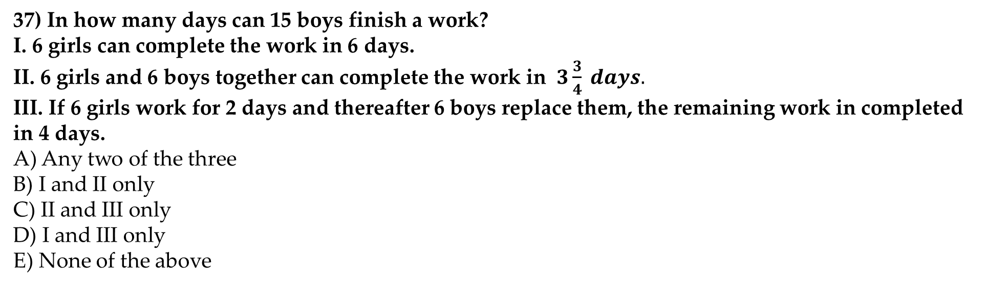
Chain Rule
37) In how many days can 15 boys finish a work?
I. 6 girls can complete the work in 6 days.
II. 6 girls and 6 boys together can complete the work in $3\frac{3}{4} days.$
III. If 6 girls work for 2 days and thereafter 6 boys replace them, the remaining work in completed in 4 days.
A) Any two of the three
B) I and II only
C) II and III only
D) I and III only
E) None of the above
Notes:
Difficulty level : expert(optional)
Option A

Slide 45
Any Doubts???

